Slide 1
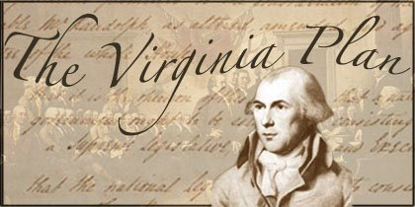

Slide 2
The Articles of Confederation was the first form of government
It had a weak federal government

Slide 3
Under the Articles of Confederation the individual states held all of the power

Slide 4
The Virginia Plan was based on some of the ideas of French political theorist Montesquieu (Mon-tess-q)

Slide 5
James Madison, Alexander Hamilton and John Jay wrote the “Federalist Papers”
Persuasive documents asking for a strong federal government

Slide 6
James Madison, architect
Edmund Randolph, presenter
Concerned about objectives for the new constitution
Constitutional Convention scheduled to meet in Philadelphia

Slide 7
James Madison, the “Father of the Constitution” helped frame the Bill of Rights and much of the U.S. Constitution
Madison kept meticulous notes of the convention’s proceedings

Slide 8
The Virginia Plan (also known as the Randolph Plan, after its sponsor, or the Large-State Plan)
A proposal by Virginia delegates for a bicameral legislative branch

Slide 9
The Virginia Plan was drafted by James Madison while he waited for a quorum to assemble at the Constitutional Convention of 1787

Slide 10
Edmund Randolph, the Virginia governor at the time, officially put it before the convention on May 29, 1787, in the form of 15 resolutions

Slide 11
The purpose of the plan was to protect the large states’ interest in the new government

Slide 12
One of the resolutions proposed a new form of national government having three branches--legislative, executive and judicial

Slide 13
The issue facing the convention was states representation.
1. Proportionate to population, with larger states having more votes than less-populous states?
2. Or by equal representation for each state, regardless of its size and population?

Slide 14
The Virginia Plan proposed a legislative branch consisting of two chambers or a bicameral legislature
Each state would be represented according to the number of free inhabitants

Slide 15
Larger states supported it
Smaller states generally did not support it

Slide 16
New Jersey Plan supported a single-chamber legislature
Each state would have only one vote

Slide 17
Neither the Virginia nor the New Jersey Plans were immediately printed for the delegates
Since the proposals were the subject of debate, many of the delegates made handwritten copies

Slide 18
In the end, the convention settled on the Connecticut Compromise
It created a House of Representatives based on population
It created a Senate with each state having the same number of votes

Slide 19
The Connecticut Compromise was a middle ground between the Virginia Plan and the New Jersey Plan
Instead of having one house with equal representation, there would be two houses

Slide 20
The Virginia Plan also addressed other issues besides legislative representation that did not make it into the constitution

Slide 21
The Virginia Plan is best known for creating new ideas for a national government
State representation by population
The three branches of government

Slide 22
The Virginia Plan provided the framework for the constitution
After much debate, expansion, development, and compromise by the framers, it became part of the Constitution of the United States

